Slide 1


Models in Engineering
Week 4: Models in Verification and Validation
Project
Name
Tomas Mawyin

Slide 2
Instructions
Before you begin, you should save your Project Portfolio on your local drive. We recommend the following format:
Lastname_Firstname_Course2_Week4
Please note: You will not be able to re-download your file after submission; therefore, please keep this file in a central location for future reference.
The work in the project deliverable is individual.
You will be self-assessing your work as well as the work of three peers. If you have any questions, feel free to post to the Discussion Forum.
Although work is strictly individual, sharing ideas and concepts with other students is encouraged.
Note: edX has a 10MB file size limit for document submission. If you have selected large image(s), you may need to resize before submitting, OR you may simply include a web URL for the image in the image location. Be sure to submit your assignment at least one hour before the deadline to provide time for troubleshooting.
Once the deadline passes, you will not be able to upload the document and therefore will not be able to submit and complete the assignment.

Slide 3
Week 4 Project
Overview
In the fourth and final project activity of this course, you will choose a product/system/sub-system you have worked on. You will then develop the V&V framework and determine the V&V techniques and V&V plan of those models.
Note that some Scratch Pages are included at the end of this document for you to capture any ideas, sketches, etc. that you have as you work through the project. These will not be assessed and you are not required to submit them with your project (but you may do so if you think they offer any additional insight into your thinking process!).
REQUIRED STEPS:
Step 1: Develop the V&V framework
Step 2: Develop the V&V options
Step 3: Elaborate on one model
Step 4: Review and submit your project

Slide 4
Step 1: Develop the Verification and Validation Framework
Dr. Anna Thornton talked about determining the V&V framework of your system from a product, process, and business perspective. Here you will focus on just product and process.
A. Choose a scope -- for example, bicycle models 1,2,3 built at the Charleston, SC assembly plant, or software product A.
B. For the grey boxes (the framework labels), decide whether these are appropriate names in your industry. If they are not appropriate, please change the names.
C. For the blue boxes, customize the generic questions to your industry. You don’t need to answer the questions here; just write an example question in each box.
Scope : | Determine the V&V of an Electric Powered Steering System for an Automobile
 | Product | Process
System (including environment) | Does the steering system works as expected in all environmental conditions? Does the steering system meets the performance needed? | Can the steering system be assembled as expected? Is the entire supply chain efficient?
Sub-system/Function | Does the electronic power sub-system (motor, ECU, software, electronics) work as expected? Does it produce the necessary performance? | Is the production of the electronic power sub-system efficient? Can the sub-system be assembled as expected?
Part | Does the motor meet the design and performance requirements? | Can the supplier chain meet the desired production rates?
Feature | Do the motor features (geometry, materials, finish, etc.) meet requirements? | Does the production reliably creates the required features?

Slide 5
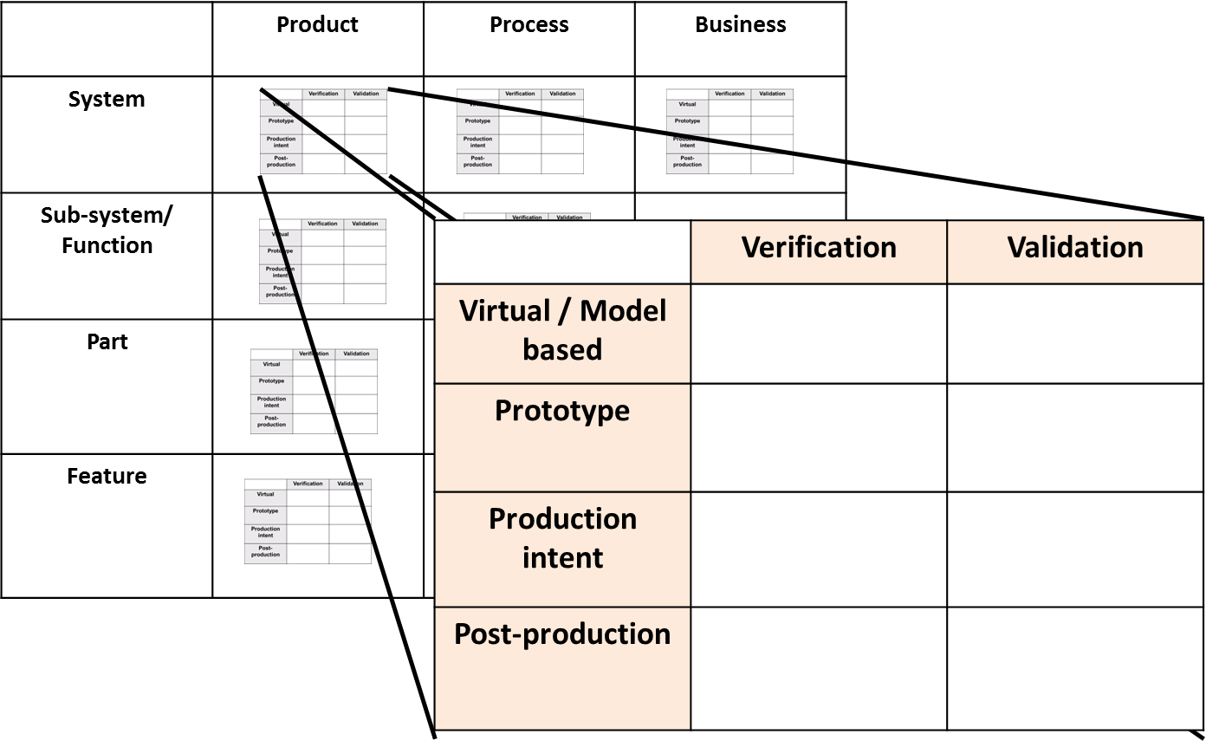
Step 2: Develop the Verification and Validation Options
If you changed the grey boxes in Step 1, please change them in the table below as well.
For each empty box in the framework below, describe a potential V&V method you could employ. You may employ the same method in multiple boxes. In reality you may not need all 32 types of V&V – you might choose to use a model only for subsystem function V&V.
 | Product |  | Process
System | Models | CAD simulations, Failure Mode Analysis, Functional Safety | Models | Event simulation, Manufacturing models for capability
 | Prototype | Bench and vehicle testing, design reviews | Prototype | Pre-production low fidelity prototypes
 | Production Intent | Bench and vehicle testing. Expert and consumer evaluation, design reviews | Production Intent | Run at rates, Launch
 | Post-production | Warranty analysis, post-production teardowns | Post-production | Key performance indicators
Sub-system/ Function | Models | CAE analysis, Software models | Models | Virtual assembly
 | Prototype | Testing (functional and performance) | Prototype | Prototype assembly process analysis
 | Production Intent | Testing (functional and performance) | Production Intent | Pilot production process
 | Post-production | Failure report analysis | Post-production | Defect analysis
Part | Models | CAE analysis, Electrical analysis | Models | Capability simulations
 | Prototype | Bench testing | Prototype | Assembly process analysis
 | Production Intent | Product testing and inspection | Production Intent | Pilot production process
 | Post-production | Warranty analysis and teardowns | Post-production | Defect analysis
Feature | Models | CAD verification | Models | N/A
 | Prototype | Supplier analysis and review | Prototype | Manufacturing process
 | Production Intent | Geometric and Tolerance analysis | Production Intent | Pilot production process
 | Post-production | Statistical Process Control | Post-production | Process auditing

Slide 6
Step 3: Elaborate on One Model
For one of the eight potential models you identified in Step 2, do the following:
A. State the name of the product on which it would be used, and give a brief explanation of the product.
B. Highlight one or two critical issues that this model would help you verify and/or validate. For example, a critical issue could be, “Will the software crash under any operating conditions?”
C. Provide a potential name of the model, and a brief description of how the model does or should work.
D. On a scale of 1 (low) – 10 (high), describe how well you think the model will accomplish the V&V task.
A: Electronic Power Pack (EPP): The EPP contains the motor, ECU, software, and electronics that help the steering system provide assist to the user when turning a vehicle. In general, it’s because of these sub-system that the driver does not need to put much effort when steering the vehicle.
B: I will be discussing the Software & Requirements Model for the EPP. Critical issues that the model validates include:
The model validates the specification provided to the supplier. By employing the model, it is possible to ensure that all requirements given to the suppliers are robust, unambiguous, and complete.
The model also provides a good characterization of the assist provided to the user. It is possible to understand the performance of the system using this model.
Combined with vehicle simulators, this model provides a way to validate the vehicle communication and the effects of any power or communication failures.
C: The model is named “EPP System Model”. This is usually a Simulink model that integrates the vehicle communication (signals required from other vehicle modules), the power system, and the motor control for the steering function. The operation of the model is very simple. At a high level, the model has 3 main inputs, voltage, signals from other modules, and sensor information from the steering wheel. The output is generally a set of signals that indicate the state of the steering system and a motor control signal that turns the motor as required.
The implementation of the model is the difficult part because it requires expert knowledge of control systems, steering mechanics, and vehicle communication. The model have different state machines and tuning tables that translate to the proper communication, diagnostics, and steering performance.
D: These models have been used to provide an initial definition of the steering system performance. If all the communication and power requirements are modelled properly, this model would be rated 9/10, since it accomplishes the V&V task.

Slide 7
Step 4: Review and Submit Project
Submit your completed Week 4 Project Portfolio file
Note: The maximum file size that can be submitted is 10MB.
Assess both your own file and your peers’ completed Week 4 Project Portfolios against the Week 4 scoring rubric and determine how well you and your peers
The scoring rubric can be downloaded from the course in the Resources/Downloads tab on the top navigation.

Slide 8
Scratch Page*
Reminder: edX has a 10MB file size limit for document submission. If you have selected large image(s), you may need to resize before submitting, OR you may simply include a web URL for the image in the image location. Be sure to submit your assignment at least one hour before the deadline to provide time for troubleshooting.

Slide 9
Scratch Page*
Reminder: edX has a 10MB file size limit for document submission. If you have selected large image(s), you may need to resize before submitting, OR you may simply include a web URL for the image in the image location. Be sure to submit your assignment at least one hour before the deadline to provide time for troubleshooting.

